Slide 1
Lab 2 – CNN Classifier
Department of Computer Science, NCTU
TA Yan-Yu, Tien

Slide 2
Important Rules
Important Date :
Report Submission Deadline: 9/16 (Wed) 11:59 a.m.
Demo date: 9/16 (Wed)
Turn in :
Experiment Report (.pdf)
Source code (.py)
Notice :
zip all files in one file and name it like 「DLP_LAB2_yourID_name.zip」,
ex: 「DLP_LAB2_0760447_王大明.zip」
Email to :
92242@saes.tc.edu.tw
Subject: MTK_DLP_LAB2_yourID_name

Slide 3
Lab Description
Familiar with convolutional neural network structure
Familiar with convolutional layer design by using pytorch
Understand the difference of activation functions
Finish the classifier task
Custom dataloader is not required in this lab

Slide 4
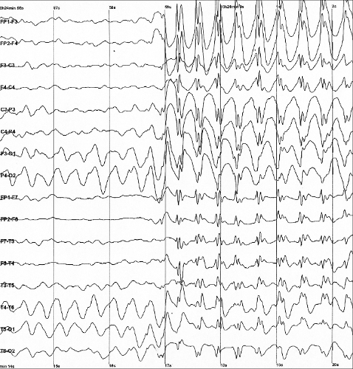
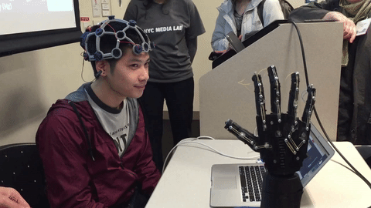
Lab Objective
In this lab, you will need to implement simple EEG classification models which are DeepConvNet, EEGNet with BCI competition dataset. Additionally, you need to try different kinds of activation function including『ReLU』,『Leaky ReLU』, 『ELU』.

Slide 5
Requirements
Implement the DeepConvNet, EEGNet with three kinds of activation function including『ReLU』,『Leaky ReLU』, 『ELU』.
In the experiment results, you have to show the highest accuracy (not loss) of two architectures with three kinds of activation functions.
To visualize the accuracy trend, you need to plot each epoch accuracy (not loss) during training phase and testing phase.

Slide 6
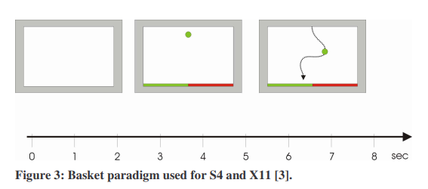
Dataset
BCI Competition III – IIIb
[2 classes, 2 bipolar EEG channels]
Reference: http://www.bbci.de/competition/iii/desc_IIIb.pdf
Notes:
那首先講一下這次使用的 dataset
這邊我們用的是 BCI Competitioin 的 dataset
綠色點點要落進綠色區域
中間球可能會移動
要想左邊左邊左邊 直到球進入綠色的區域
這樣我們就得到”往左”這個想法比較強烈的腦波
那反過來也會得到往右的腦波

Slide 7
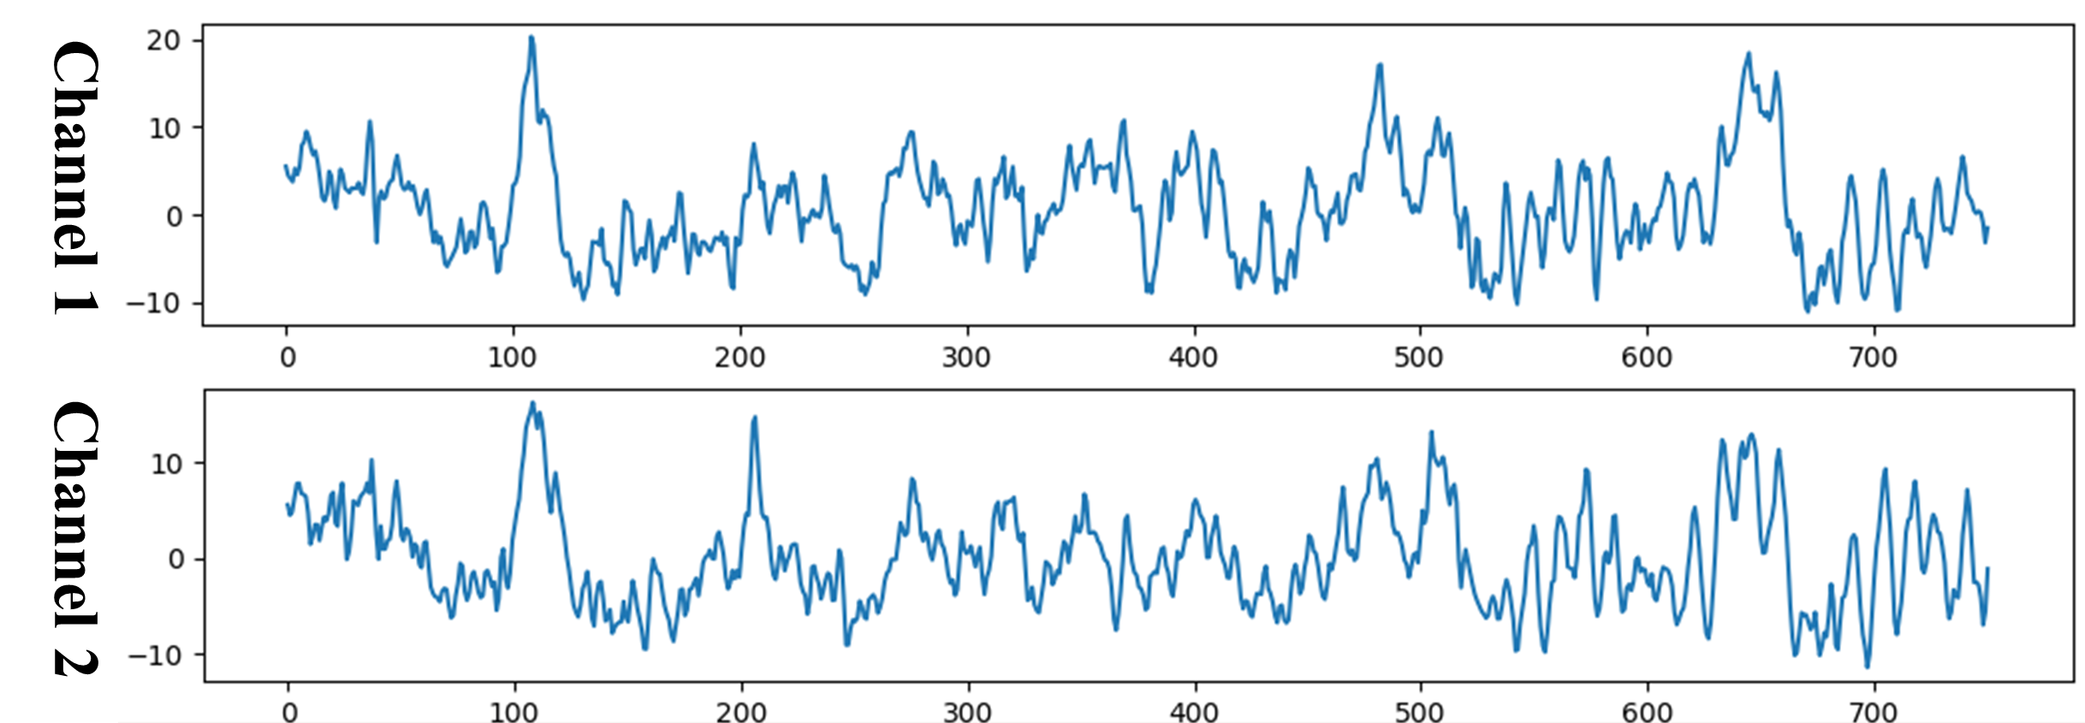
Prepare Data
Training data: S4b_train.npz, X11b_train.npz
Testing data: S4b_test.npz, X11b_test.npz
To read the preprocessed data, refer to the “read_bci_data.py”.
Prepared data
Train data: [1080, 1, 2, 750]
Train label: [1080]
Test data: [1080, 1, 2, 750]
Test label: [1080]
Input: [B, 1, 2, 750]
B: batch size

Slide 8
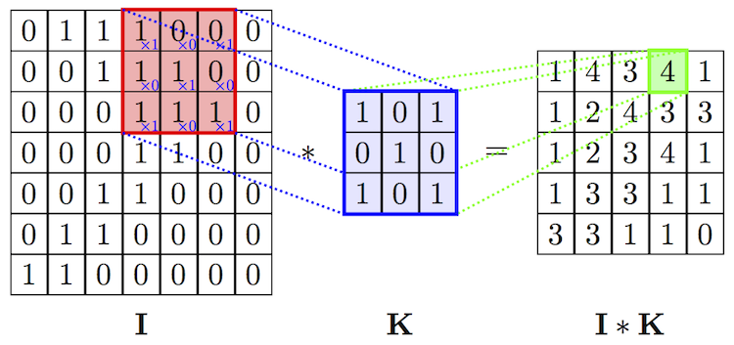
Convolution layer

Slide 9
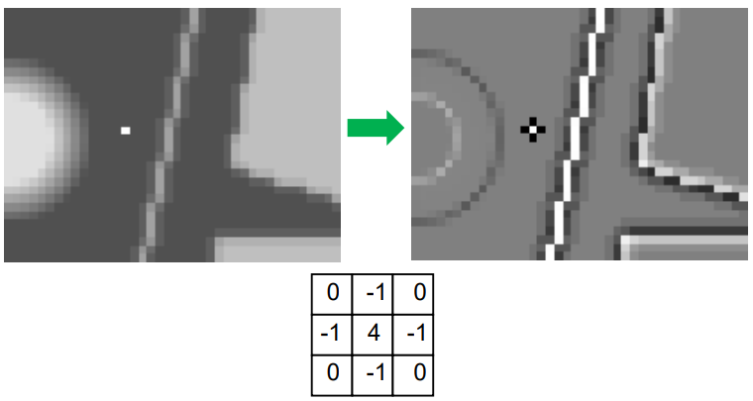
Convolution layer

Slide 10
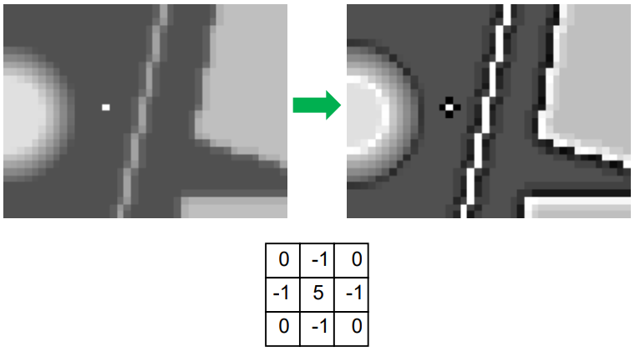
Convolution layer

Slide 11
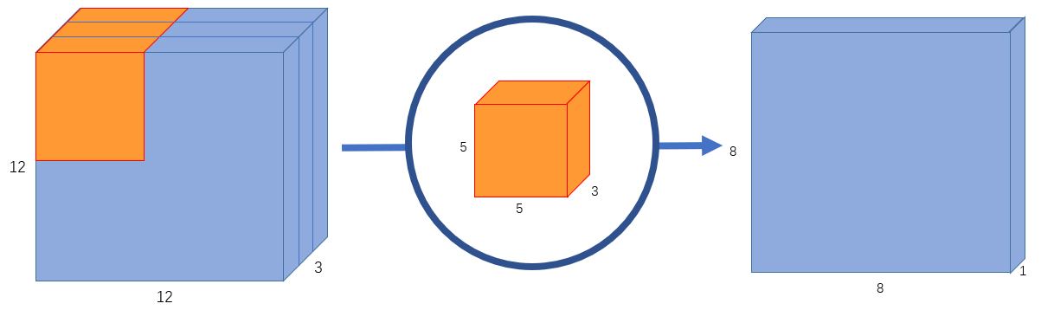
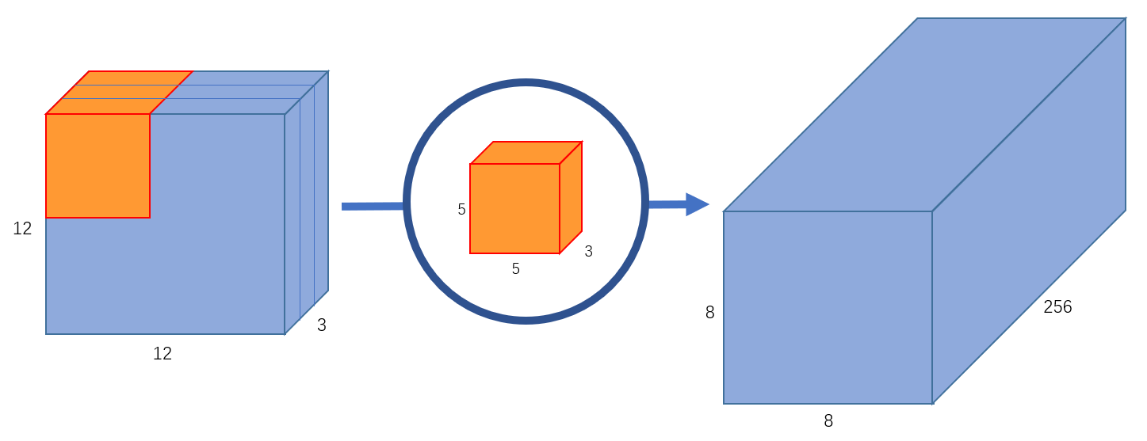
Convolution layer
Reference: https://towardsdatascience.com/a-basic-introduction-to-separable-convolutions-b99ec3102728

Slide 12



Convolution layer
kernal_size=3 in convolution
padding=1 in convolution
stride=2 in convolution
Reference: https://towardsdatascience.com/intuitively-understanding-convolutions-for-deep-learning-1f6f42faee1

Slide 13
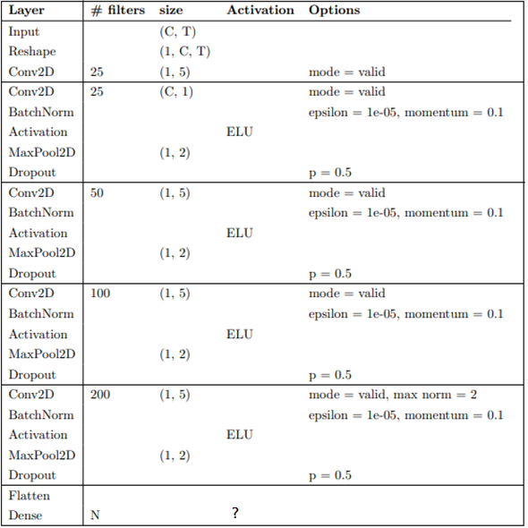
DeepConvNet
You need to implement the DeepConvNet architecture by using the following table, where C = 2 and T = 750.
The input data has reshaped to [B, 1, C, T]

Slide 14
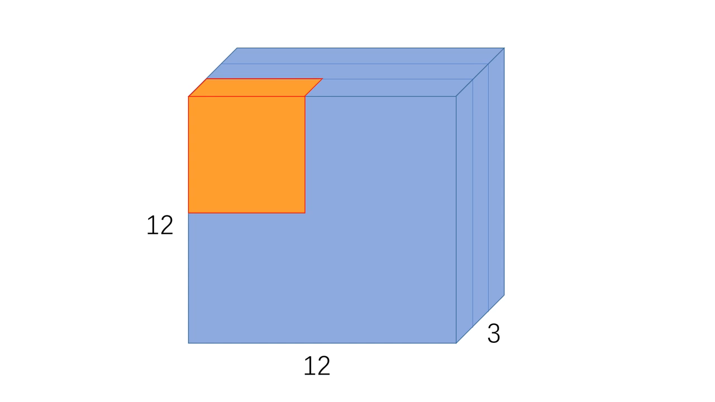
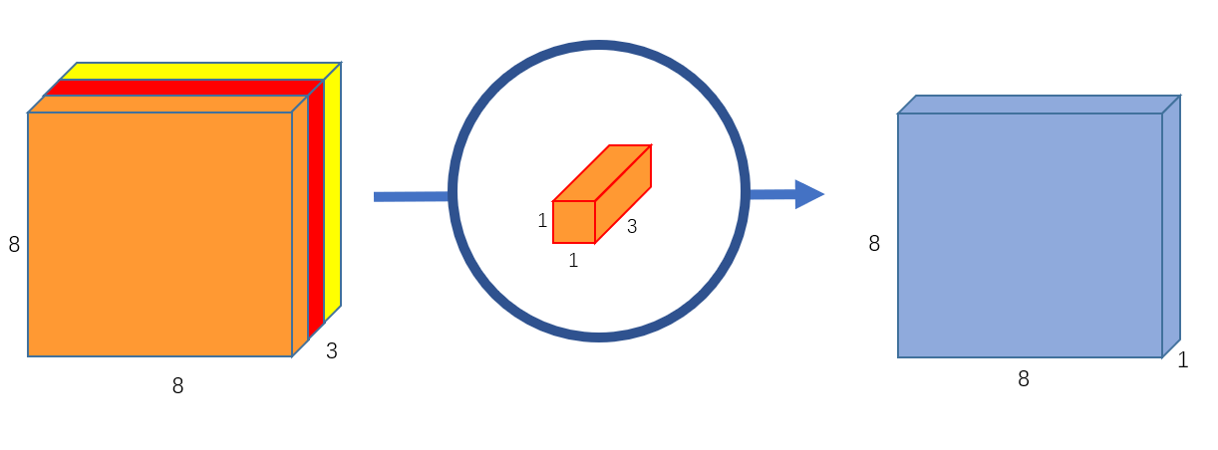
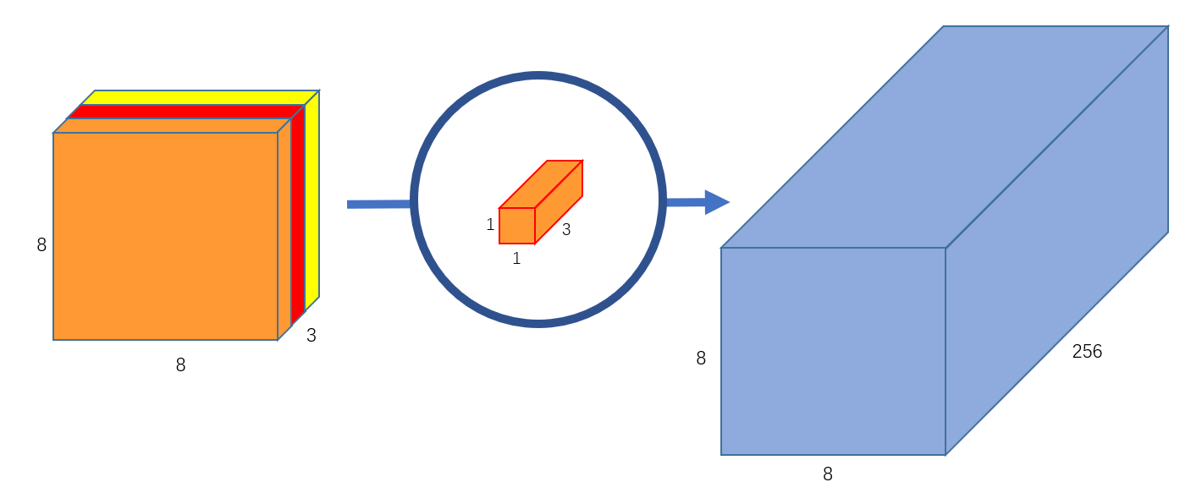
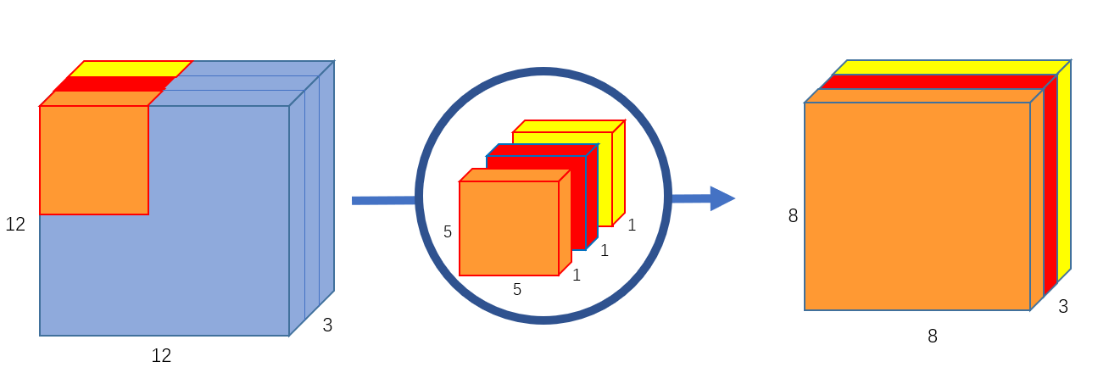
Depthwise separable convolution
1- Depthwise Convolution
2- Pointwise convolutions
Reference: https://towardsdatascience.com/a-basic-introduction-to-separable-convolutions-b99ec3102728
Notes:
Google mobileNet

Slide 15
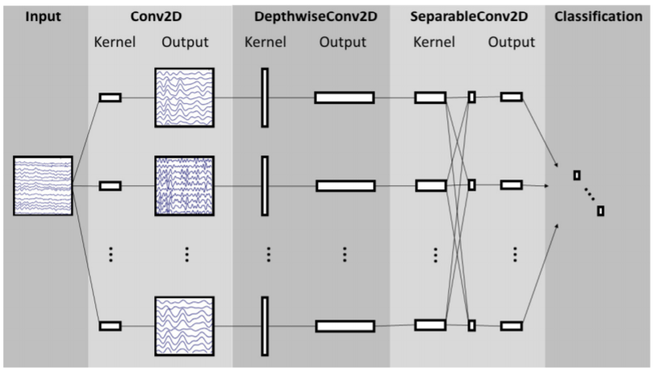
EEGNet
Reference: Depthwise Separable Convolution
https://towardsdatascience.com/a-basic-introduction-to-separable-convolutions-b99ec3102728

Slide 16
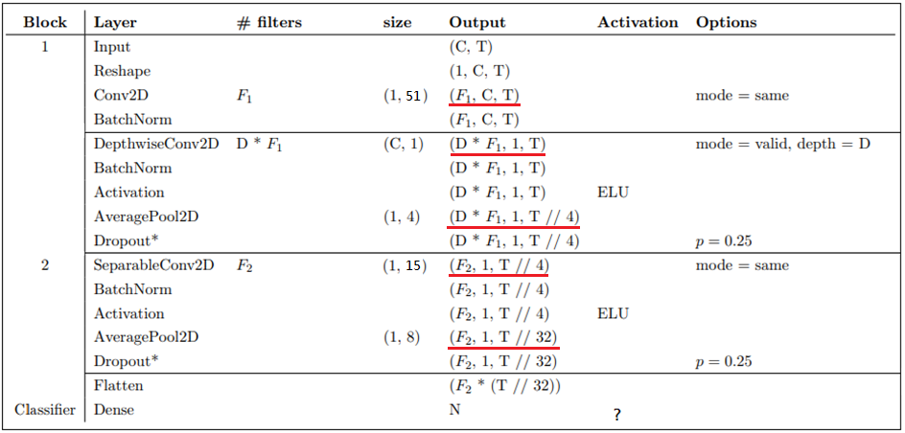
EEGNet
EEGNet implementation details
EEGNet architecture
C = number of channels
T = number of time points
F_1 = number of temporal filters
(recommend F_1=16)
D = number of spatial filters
(recommend D=2)
F_2 = number of pointwise filters
(recommend F_2=32)

Slide 17
Classifier
Classifier category
Binary classifier
Multi class classifier
Multi label classifier
Output layer activation function
Softmax ex. [-0.5, 1.2, -0.1, 2.4] → [0.04, 0.21, 0.05, 0.70] (sum=1)
Sigmoid ex. [-0.5, 1.2, -0.1, 2.4] → [0.37, 0.77, 0.48, 0.91]
Loss function in pytorch (cross entropy)
nn.CrossEntropyLoss = softmax + cross entropy
nn.BCELoss = Binary Cross Entropy
nn.BCEWithLogitsLoss = Sigmoid + BCELoss
Notes:
Binary : 是非題
Multi class: 單選題
Multi label: 多選題
Model output 可能有正負/ 大小
Activation func 把數字轉換成機率
Softmax 只有一個正確答案 互斥輸出 機率加總=1
Sigmoid多個正確答案 非獨占輸出

Slide 18
Hyper Parameters
Batch size = 64
Learning rate = 1e-2
Epochs = 150
Optimizer: Adam
nn.Conv2d Doc
https://pytorch.org/docs/stable/generated/torch.nn.Conv2d.html
Hint: stride, padding, groups
You can adjust the hyper-parameters according to your own ideas.
You cannot modify the architecture of DeepConvNet

Slide 19
Report Spec
Introduction (10%)
Experiment set up (35%)
The detail of your model
DeepConvNet
EEGNet
Explain the activation function (ReLU, LeakyReLU, ELU)
Explain the output layer activation function and loss function
Experiment result (30%)
The highest testing accuracy
Two models with three activation functions
Anything you want to present
Comparison figures
Accuracy curve for two models
Discussion (25%)
Depthwise separable convolution improve what issue in normal convolution
Your training strategy
Anything you want to share

Slide 20
Result Comparison
You have to show the highest accuracy (not loss) of two architectures with three kinds of activation functions.
acc | ELU | ReLU | Leaky ReLU
EEGNet | 84.90% | 87.04% | 87.68%
DeepConvNet | 81.75% | 82.75% | 81.48%

Slide 21
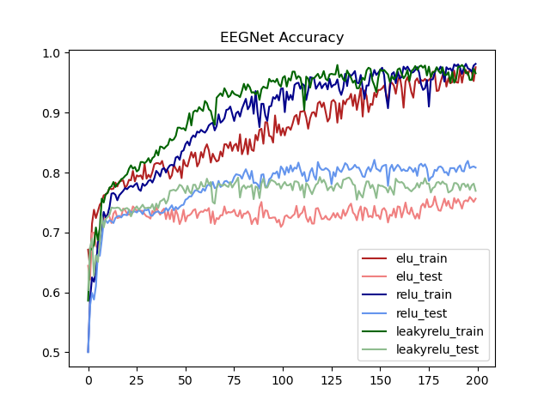
Result Comparison
To visualize the accuracy trend, you need to plot each epoch accuracy (not loss) during training phase and testing phase.
In this part, you can use the matplotlib library to draw the graph.

Slide 22
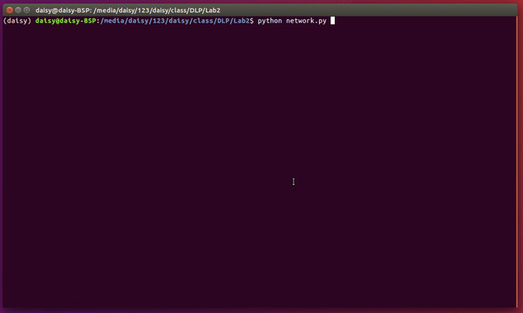
Example

Slide 23
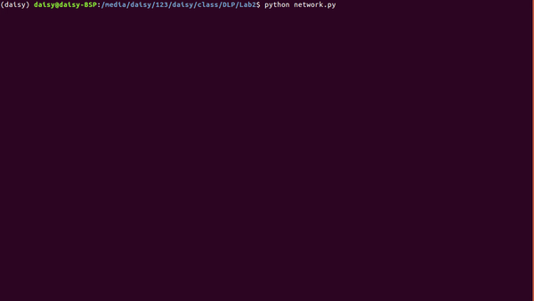
Example

Slide 24
---- Criterion of result (40%) ----
Accuracy > = 87% = 100 pts
Accuracy 85~87% = 90 pts
Accuracy 80~85% = 80 pts
Accuracy 75~80% = 70 pts
Accuracy < 75% = 60 pts
Score: 40% experimental results + 60% (report+ demo score)
P.S If the zip file name or the report spec have format error, it will be penalty (-5).

Slide 25
Reference
[1] EEGNet: A Compact Convolutional Neural Network for EEG-based Brain-Computer Interfaces

Slide 26
Custom Dataloader Practice Lab

Slide 27
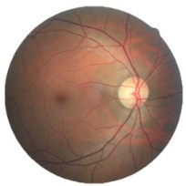
Lab Objective
Classifier for diabetic retinopathy (糖尿病所引發視網膜病變) analysis with ResNet architecture
This dataset provided with a large set of high-resolution retina images taken under a variety of imaging conditions. Format: .jpeg
Class .
0 - No DR 1 - Mild 2 - Moderate 3 - Severe 4 - Proliferative DR
Reference : https://www.kaggle.com/c/diabetic-retinopathy-detection#description

Slide 28
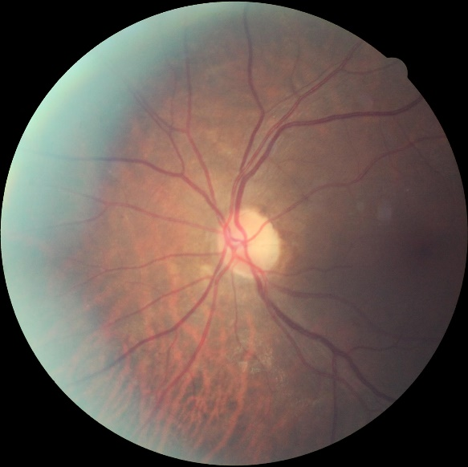
Prepare Data
Download data
28,099 images for training
7025 for testing
The image resolution is 512x512 and has been preprocessed.
Input: [B, 3, 512, 512] Output: [B, 5] Ground truth: [B]
512 x 512

Slide 29
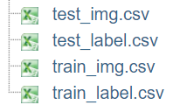
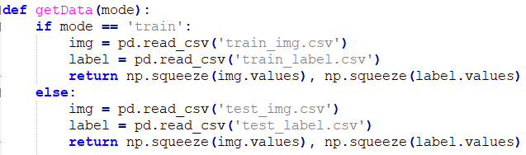
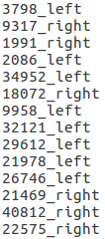
Prepare Data
Image Format: .jpeg
Please do not sort !!!

Slide 30
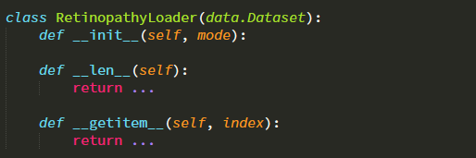
Dataloader
Implement your own custom DataLoader
Below is the skeleton that you have to fill to have a custom dataset, refer to “dataloader_practice.py”

Slide 31
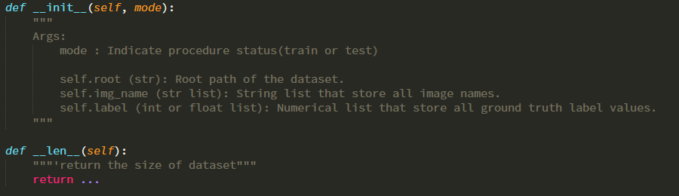
Dataloader

Slide 32
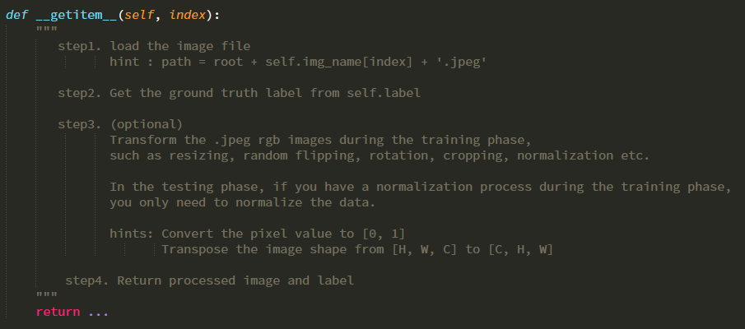
Dataloader

Slide 33
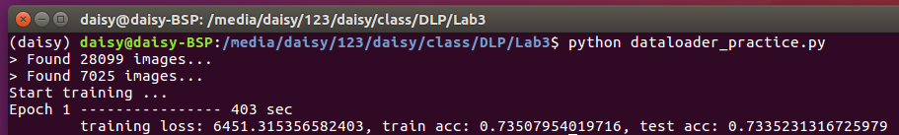
Result

